Slide 1
Artificial Photosynthesis
By: Ella Engelen

Slide 2
Overview:
History - Who and When it was Conceived
Plan and Implementation
Upsides/Pros to the Advancement
Downsides/Cons to the Advancement
Summary
References

Slide 3
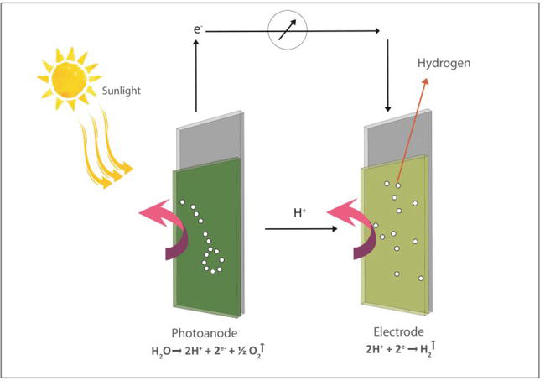
What is Artificial Photosynthesis?
Artificial Photosynthesis is the chemical process that mimics the natural process of photosynthesis, or the process of turning light energy into chemical energy, and the process also produces oxygen.
3 steps:
light capture and electron transport
water splitting (into hydrogen and oxygen)
reduction of carbon dioxide
Notes:
The concept of artificial photosynthesis is to imitate this fundamental process that occurs within natural organisms and manipulate it to fit our societal needs. The term can refer to any scheme which captures and stores solar energy in the chemical bonds of a fuel. Hence, rather than producing glucose, valuable fuels such as hydrogen or methanol are created.
Artificial photosynthesis system (APS) uses biomimetic systems to duplicate the process of natural photosynthesis that utilizes copious resources of water, carbon dioxide and sunlight to produce oxygen and energy-rich compounds and has potential to be an alternative source of renewable energy.

Slide 4
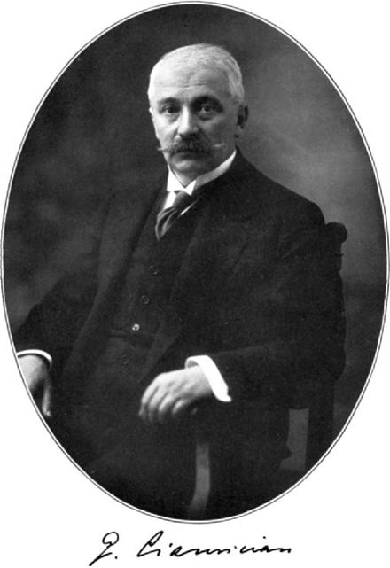


History-People;
(1912) Giacomo Ciamician: The Italian chemist who first introduced this idea and published a book. He believed moving away from fossil fuels would be better for humanity and the environment.
(1960)Akira Fujishima- Discovered the photocatalytic properties of titanium dioxide, which can be used for hydrolysis. He thought of the “Honda-Fujishima” effect.
(1983)William Ayers- Created the first visible light water splitting. This demonstrated water photolysis, or the “artificial leaf”, and was cheap. It evolved into what it is today.
Notes:
Artificial photosynthesis was first anticipated by the Italian chemist Giacomo Ciamiciand uring 1912.[ In a lecture that was later published in Science[ he proposed a switch from the use of fossil fuels to radiant energy provided by the sun and captured by technical photochemistry devices. In this switch he saw a possibility to lessen the difference between the rich north of Europe and poor south and venture a guess that this switch from coal to solar energy would "not be harmful to the progress and to human happiness."
During the late 1960s, Akira Fujishima discovered the photocatalytic properties of titanium dioxide, the so-called Honda-Fujishima effect, which could be used for hydrolysis.
Visible light water splitting with a one piece multijunction semiconductor device (vs. UV light with titanium dioxide semiconductors) was first demonstrated and patented by William Ayers at Energy Conversion Devices during 1983.This group demonstrated water photolysis into hydrogen and oxygen, now referred to as an "artificial leaf" with a low cost, thin film amorphous silicon multijunction sheet immersed directly in water. Hydrogen evolved on the front amorphous silicon surface decorated with various catalysts while oxygen evolved from the back side metal substrate which also eliminated the hazard of mixed hydrogen/oxygen gas evolution. A polymer membrane above the immersed device provided a path for proton transport. The higher photovoltage available from the multijunction thin film device with visible light was a major advance over previous photolysis attempts with UV or other single junction semiconductor photoelectrodes. The group's patent also lists several other semiconductor multijunction compositions in addition to amorphous silicon.

Slide 5

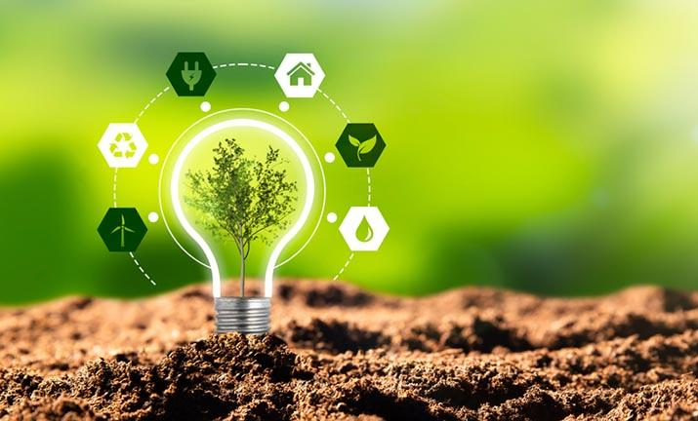
Plan/Implementation
Make the small process more efficient, cost effective, and durable
Make the invention accessible to everyone
Commercialize the product
Fully convert from fossil fuels to this renewable energy
Become self-sustainable
Notes:
While current artificial photosynthesis methods are far less efficient than the natural process, there has been continual progress in the field. One of the reasons that the technology is being pursued is that, compared to current solar panel technology, molecular nanoparticles are cheaper, lighter, and more environmentally sound. Aside from providing a renewable energy source and eliminating our reliance on rapidly diminishing fossil fuels, it has also been suggested that artificial photosynthesis on a large industrial scale could reverse global warming since the process consumes carbon dioxide and releases oxygen. With the potential of such beneficial impacts on the environment and our energy supply, continued research into combining nanotechnology and natural processes should remain a central goal.
The top priority of researchers is to search sources of renewable energy that can be used to get some relief from the current state of crisis all over the world [28]. The airplane was created inspired by the flight of the bird, in a similar manner natural photosynthesis serves as a model to mimic the functions of self-sustaining photo-autotroph organisms which hopefully one day create a self-sustaining world. APS already working efficiently and outperforms natural catalytic systems with respect to simplicity, charge transport and light absorption spectral range. Moreover, just as solar panels can be installed onto roofs, providing a secondary source of electricity, future artificial photosynthesis devices can also be applied to power homes as it offers a way to store energy for later use. More than 60% of oil depletion globally is because of its usage in transportation. Electric cars are an excellent alternative but recently new models of cars powered by hydrogen, the byproduct of APS claimed to revolutionize the vehicle industry. These hydrogen-powered vehicles require a very short refueling time and are environmentally friendly.
Natural photosynthesis is solely responsible for all the energy that is required to survive on this planet. In addition, photosynthesis adds energy stored in fossil fuels. It took a billions of years for evolution to make protobiont to evolve into multicellular photosynthesizing systems. To mimic, natural photosynthesis may take more than a decade of extensive research before APS is fully equipped for industrial utilization [11]. Therefore, it is imperative to try and extract energy from a biomimetic approach to this natural process. The endeavor for creating a self-sustained system using APS is still in its infancy. Many successful versions of APS has been devised but not all models are infallible and have drawback related to efficiency, instability or financial expenses. The search for a cost-effective, robust and scalable APS continues in organizations viz., Liquid Sunlight Alliance (LiSA) and Center for Hybrid Approaches in Solar Energy to Liquid Fuels (CHASE). The various attempts to practically apply APS fall short of many efficiencies but still solar fuel production by natural photosynthesis is achievable in the laboratory. The scientific community is well versed in terms and working principles of solar fuel, artificial leaf and artificial photosynthesis and working hard to provide energy using clean, green alternatives globally.

Slide 6
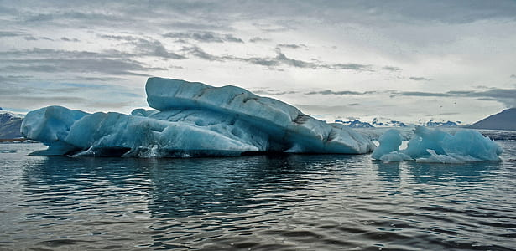
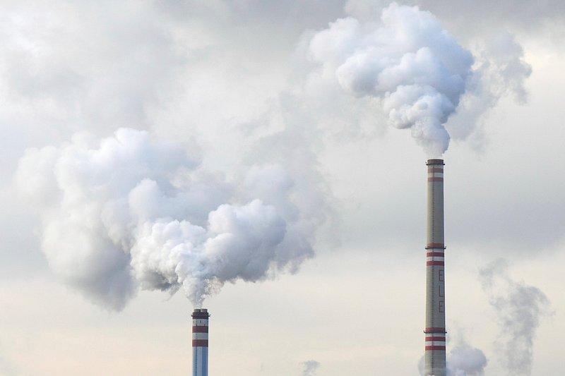

Upsides
New source of renewable energy
Increase fuel security
Provide a sustainable global economy
Reverse global warming
Notes:
Large scale employment of artificial photosynthesis can potentially provide society with renewable and storable energy in the form of valuable fuels. Hydrocarbons produced can act as substitutes for fossil fuels, and pure hydrogen can be used as a fuel as well or be channeled into a fuel cell to generate electricity.
The use of conventional fossil fuels continues to both deplete natural resources as well as emit greenhouse gases which hinder the safety of our environment.
Artificial photosynthesis devices can also function as atmospheric cleansers by extracting the excess amount of carbon dioxide and releasing back oxygen into the environment.

Slide 7
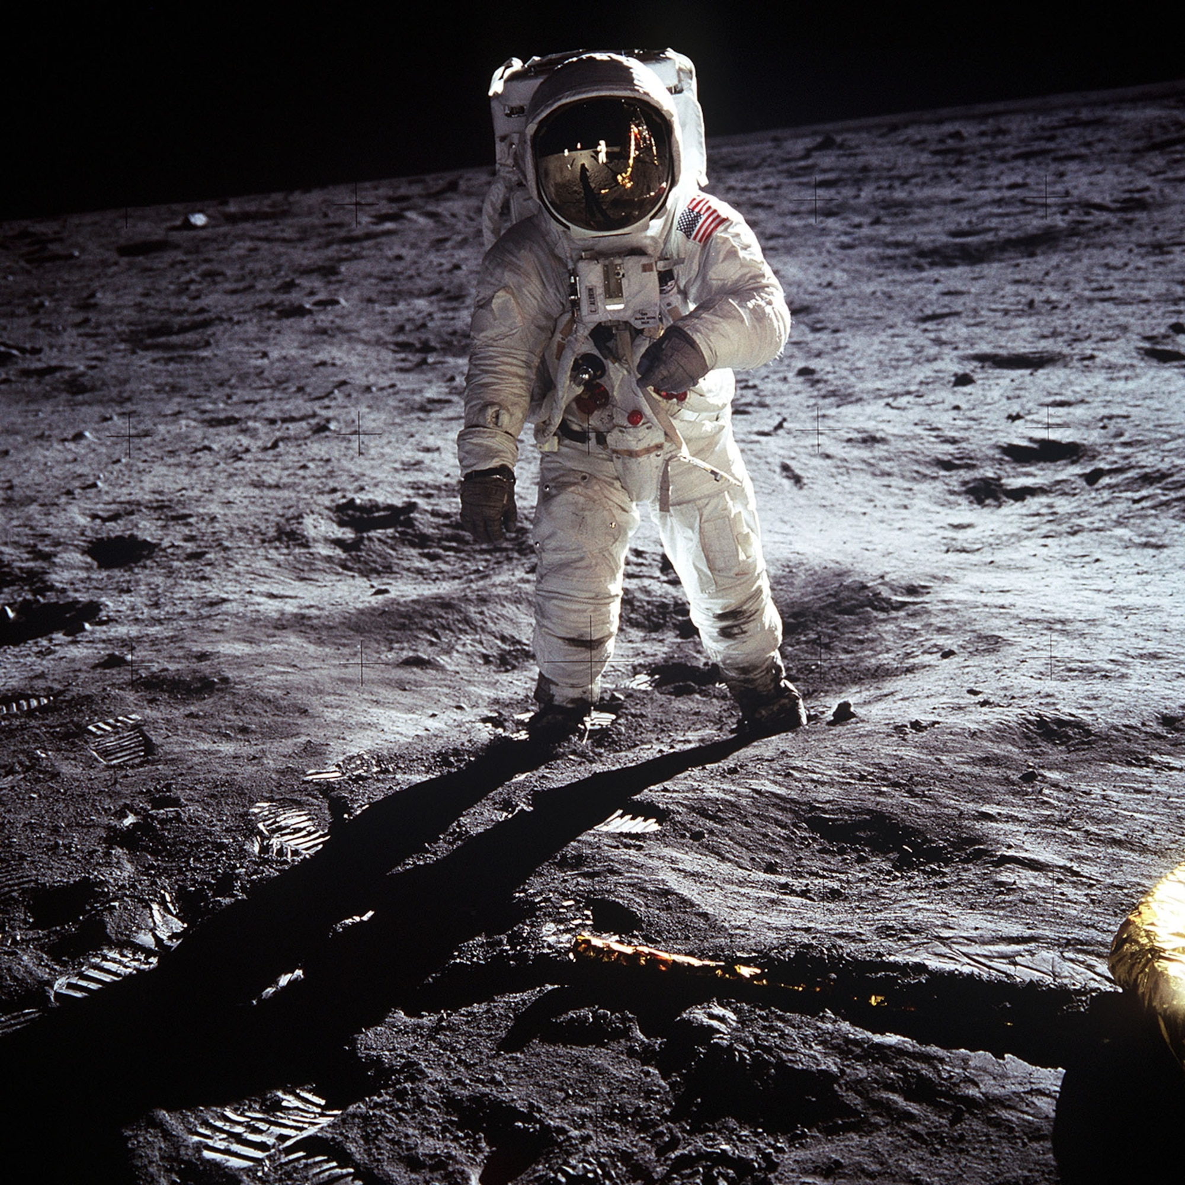
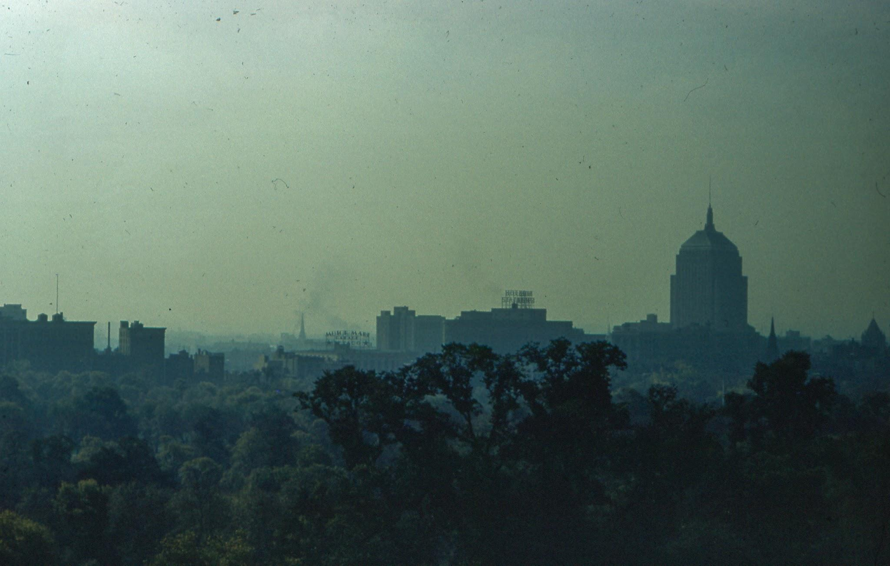

Upsides
Save the environment, and the earth
Better air quality
Sustain life on other planets without air
Replace fossil fuels
Better than solar panels
Notes:
Artificial photosynthesis as a chemical process replicates natural photosynthesis to reduce anthropogenic carbon dioxide (CO2), increase fuel security, and provide a sustainable global economy
The concept of artificial photosynthesis is similar to that of the solar panels you may spot on the top of roofs or arrayed across fields. However, the photovoltaic cells found in solar panels are designed to harness solar energy and convert it into electricity for direct application. While this can be useful, the electricity produced by solar panels is limited by its dependence on weather and time, which is limiting by the fact that it cannot be suitably stored by batteries at this point.

Slide 8
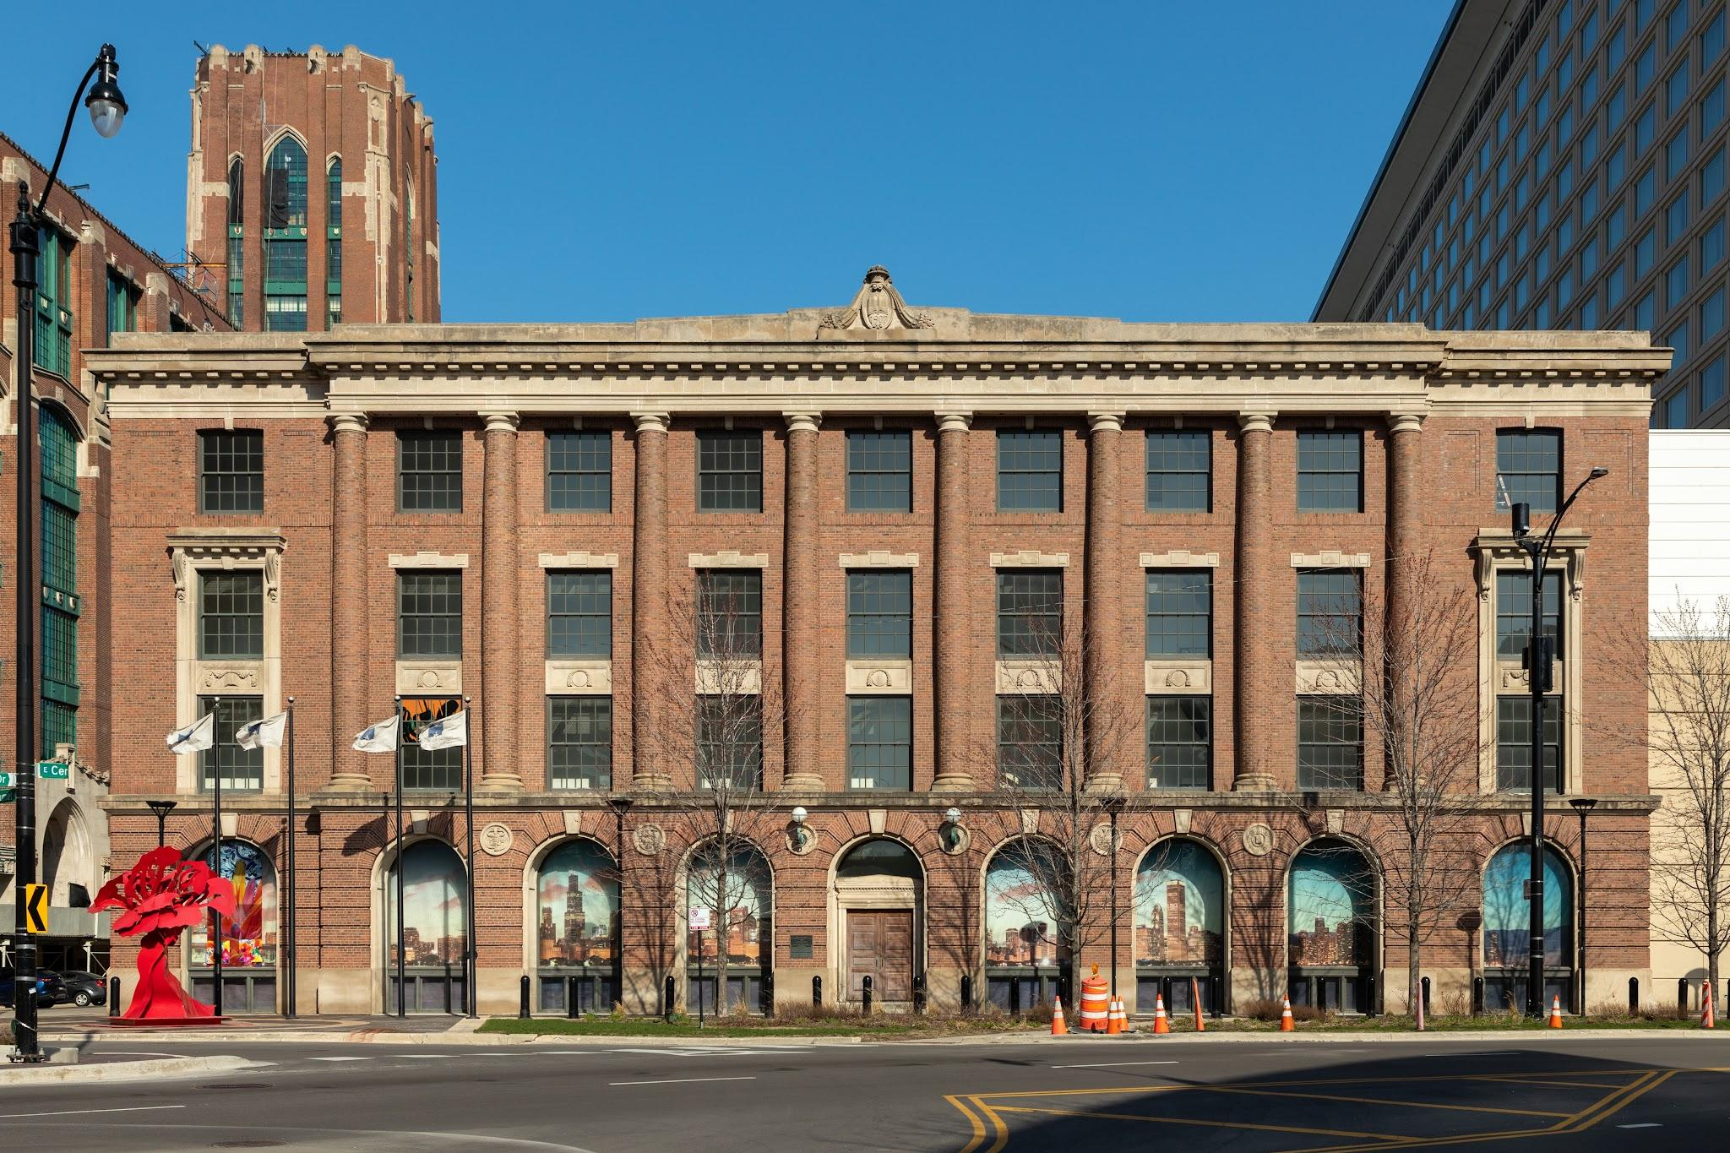
Downsides
Not very durable
Needs to be commercialized to have an impact
Hard to make without another environmental impact
Notes:
A challenge in artificial photosynthesis is to use cheap and environmentally friendly compounds. Many components currently proposed for use in artificial photosynthetic systems are expensive, toxic, inefficient, or nondurable.
There are several limitations to the advancement of this field which are mainly centered on the inability to establish a system that is cost-effective, long-term durable and has the highest efficiency.
In order to produce hydrogen with zero or low environmental impact(“green” hydrogen), all CO2 and other pollutants must be processed (i.e., separated or sequestrated) when hydrogen is extracted from fossil fuels. Thermal, electrical, photonic, and biochemical energy systems are the primary energy sources to generate hydrogen.

Slide 9


Downsides
Not efficient
Needs a lot of work and a lot more time.
Very expensive
Notes:
A challenge in artificial photosynthesis is to use cheap and environmentally friendly compounds. Many components currently proposed for use in artificial photosynthetic systems are expensive, toxic, inefficient, or nondurable.
There are several limitations to the advancement of this field which are mainly centered on the inability to establish a system that is cost-effective, long-term durable and has the highest efficiency.
In order to produce hydrogen with zero or low environmental impact(“green” hydrogen), all CO2 and other pollutants must be processed (i.e., separated or sequestrated) when hydrogen is extracted from fossil fuels. Thermal, electrical, photonic, and biochemical energy systems are the primary energy sources to generate hydrogen.

Slide 10
Summary
I am very much for this invention. This would be an incredible advancement with very little downsides and a large reward. What swayed me the most was the fact that we could reduce global warming with this technology. We could save humanity and the environment from downfall. We could become self-sustainable. This would be a huge advancement and I really hope it happens.

Slide 11
References
An Overview: Artificial Photosynthesis
Artificial Photosynthesis as an Alternative Source of Renewable Energy: Potential and Limitations
Artificial Photosynthesis
Energy Conversion
Engineering Artificial Photosynthesis
Stanford: Artificial Photosynthesis
Artificial Photosynthesis on Mars

